Slide 1


Player Insights and Betting Patterns: Data-Driven Strategies for Optimizing Player Engagement
A presentation for the leadership teams responsible for player relationship management and marketing
September 2024

Slide 2












Project Overview
Timeline & Milestones
Analysis of the Frequency of Player Engagement across Sportsbook, Vegas, Poker, and Casino products.
Determination of Bet Amount and Activity Rates for each customer group and product.
Calculation of Revenue Generated by different player segments (VIPs, high-engagement players) over time.
Determination of Total Bet Amount and Wins by player groups across key products over the analysis period.
Day 1
Project Kick off including gathering of requirements
Day 2
project team task distribution and alignment
Deliverable
Stakeholders
Results of a Player Behavior Analysis using SQL, focusing on product engagement and betting activity.
Insights presented in PowerPoint, tailored to inform the management team about player trends and opportunities for targeted marketing strategies.
Product Management Team
CRM and Marketing Team
VIP Management Team
Finance and Revenue Teams
Data Analytics Team
Executive Leadership (CEO, CFO)
Day 3
Initial data exploration and analysis of player engagement patterns
Day 4
Segmenting players by activity and product preferences; focus on VIP behavior
Day 5
Final analysis of top products and players, report generation, and key insights extraction
Assumptions
Project Team
Higher product engagement leads to increased total betting revenue.
VIP players are more likely to generate larger bet amounts across multiple products.
Players who engage in multiple products are likely to have higher overall betting activity.
Player preferences and engagement may be influenced by external factors, such as seasonal sports events.
Olagoke Somoye
Iciar Roldan
Giuseppe Nicolo
Day 6
Presentation development, final review, and delivery
Budget
The project was executed with no budget.

Slide 3

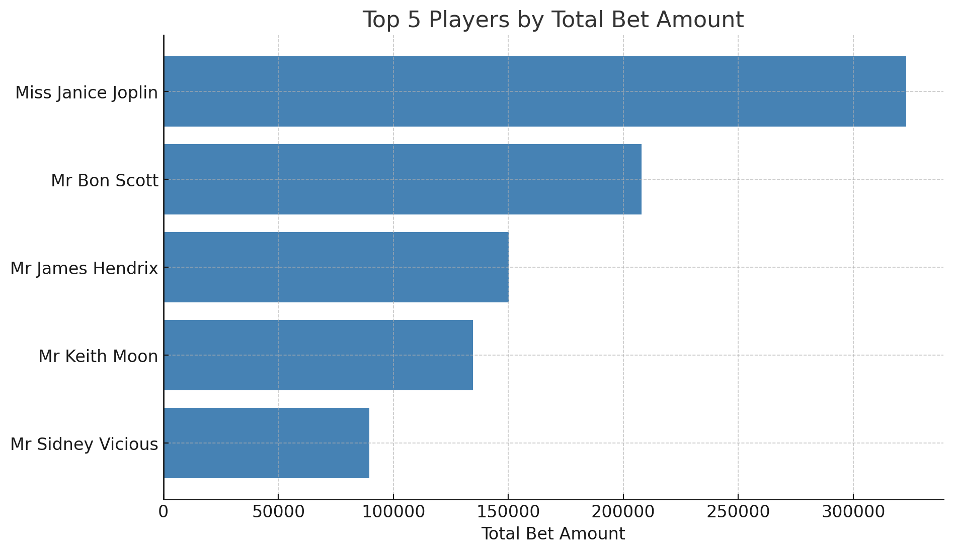
VIP Players and Product Engagement
Key Take Aways
35.5%
Top Players Drive Significant Revenue
Mid-Tier VIPs Still Contribute Significantly
Smaller Contributions but Critical Engagement
Concentration of Betting Activity:
Noticeable impact on revenue if top players reduce activity
Mitigate risk by diversifying the player base or incentivizing more mid-tier players to increase engagement
Actionable Insights for Retention and Cross-Sell:
Focus on retaining the top two contributors and cross-selling opportunities among mid-tier VIPs
22.9%
16.5%
14.8 %
9.8%

Slide 4
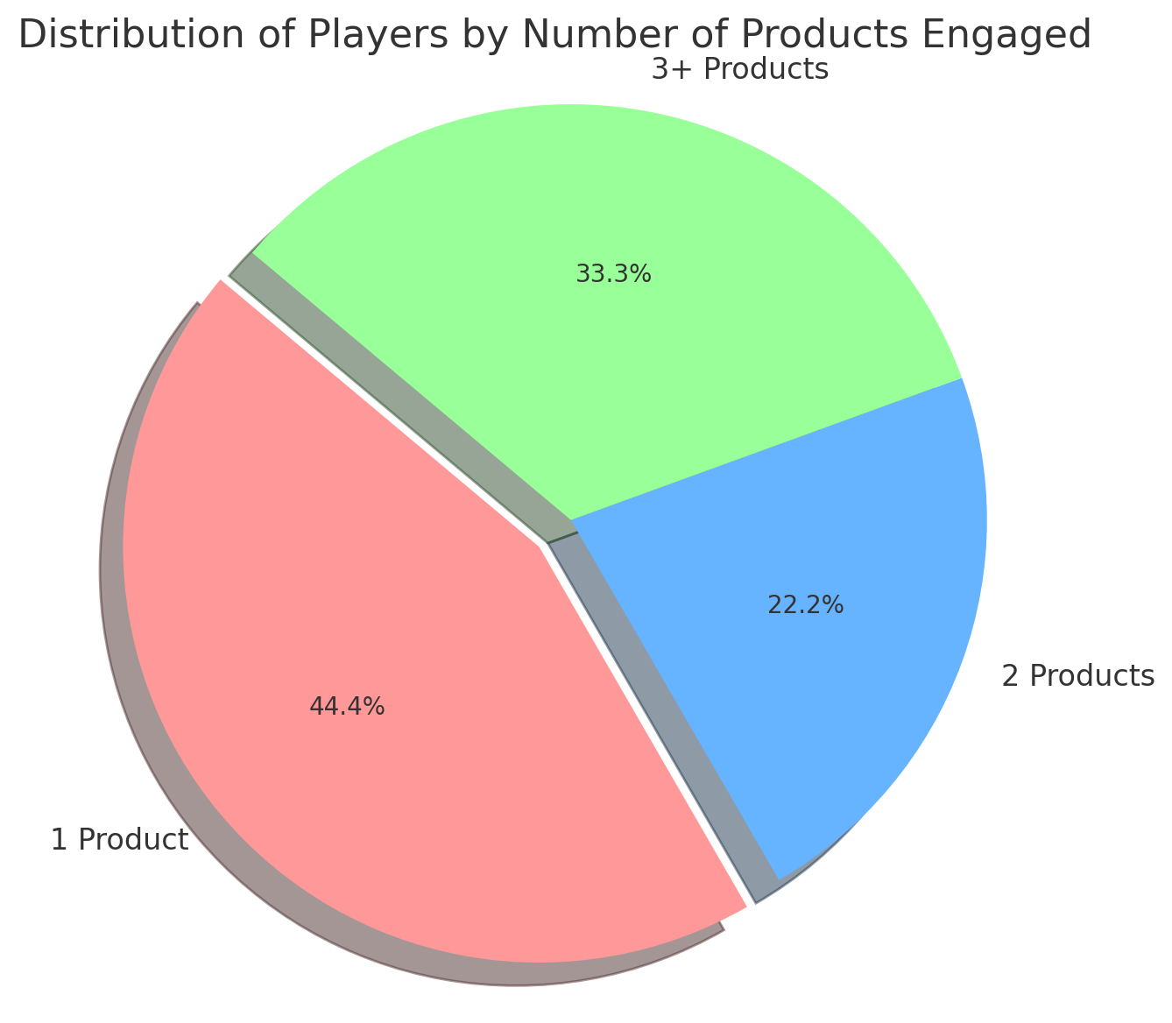
Product Usage Patterns
Key Take Aways
44.4% engage with only 1 product, indicating a significant portion of the player base is product-specific
Could benefit from personalized marketing or offers to explore other products
22.2% engage with 2 products, showcasing cross-product engagement.
Likely to have broader interests and could be incentivized to try additional products
33.3% engage with 3 or more products, which includes VIP or high-value players who have a higher overall activity
Key segment for retention strategies and high-value offers

Slide 5
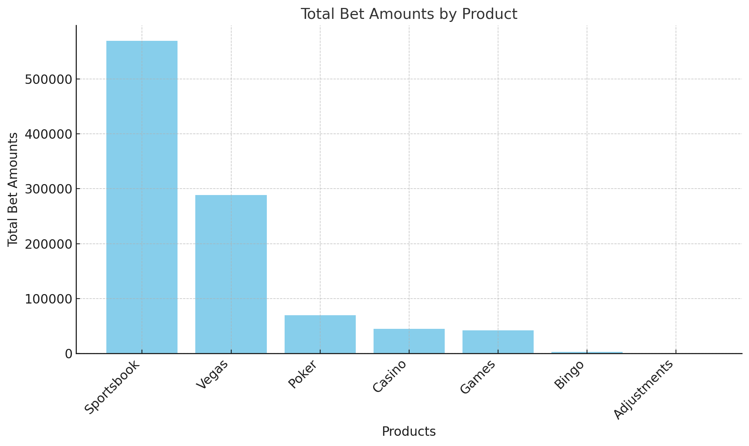
Revenue Contribution by Product
Key Take Aways
Sportsbook is the most significant driver of revenue
Vegas and Poker also show solid engagement
Casino has the least engagement
Games, Bingo and Adjustments have relatively low engagement in terms of bet amounts

Slide 6
Overview
INSIGHTS
KEY FOCUS
VIP PLAYERS
Future considerations
A small number of players, such as Janice Joplin and Bon Scott, contribute significantly to total bet amounts
70% of total bets come from just 5 players
Personalised engagement and exclusive offers for these players should be prioritised
Customer Segmentation
Identifying high-value and multi-product players allows for tailored marketing campaigns
Profit Maximization
Focus on top products, VIP players, and expanding single-product players into multi-product users to increase revenue
MULTI-PRODUCT ENGAGEMENT
60% of players engage with multiple products, while the rest are single-product users
Target multi-product players with cross-promotions
Convert single-product players by incentivising engagement with additional products
PRODUCT PREFERENCE
Sportsbook is the leading product by far, making up nearly 50% of total bets, followed by Vegas at 25%
Invest more in Sportsbook promotions and leverage Vegas as the second pillar.
Focus marketing efforts on Poker and Casino to drive more engagement

Slide 7
Thank you for your attention!
For more information, please contact the Data science project team

